Slide 1
Chemical Warfare Agents: from 1915 to the present day
Dr D J Baker
Hôpital Necker – Enfants Malades
Paris

Slide 2
Objectives of the presentation
Overview of a century or deliberate release of toxic chemical agents against both military and civil targets
The role of industry and academic research in the development of chemical weapons
Discussion of toxic agents in terms of effects on specific somatic systems
Assessment of the current threat – particularly in relation to international terrorism

Slide 3
Acknowledgement
Dr JB Cazalaa for his invaluable help in preparing the slide presentation and for many years of support and friendship

Slide 4
Toxic Trauma
This lecture concerns the effects of exposure to toxic chemical agents in both war and peace
The damage caused to man from such exposure goes beyond the conventional concept of ‘ poisoning’
Toxic trauma part of the spectrum of physical trauma which has been developed in recent years
Toxic trauma may be defined as the disruption of the function of somatic systems by mechanisms other than physical force.

Slide 5
1914 – 2014: a century of toxic trauma
Chemical warfare: the deliberate release of chemicals specifically conceived to cause harm
Chemical accidents: toxic trauma as a result of accidental release
of toxic industrial chemicals
Several chemicals belong to both classes
Chemical warfare agents grew out of toxic industrial chemicals that had legitimate industrial use – with one notable exception, Yperite

Slide 6
Classification of chemical warfare agents in terms of somatic effects
Lungs and the respiratory system
Internal respiration – chemical asphyxiants
Skin, eyes and epithelial membranes – vesicant agents
Central and peripheral nervous systems
The importance of latency when considering chemical agents

Slide 7
The origins of modern chemical warfare
Use of irritant smokes and fire in battle knows for centuries
1915 usually considered as being the start of the modern era of chemical warfare
But the origins go back well into the 19th century

Slide 8
The Industrial Revolution and the rise of the European chemical industries: the war of the chemists
William Perkin – the discovery of aniline dyes
Mauraine – the first synthetic purple
Development of the British dye industry
Later 19th century saw a rapid dominance of Germany in this area

Slide 9
Fritz Haber
German chemist and head of the Kaiser Wilhelm institute in Berlin
By 1914 Haber worked within a vast chemical production capability
Involved in planning and executing the first chemical attacks in 1915
1919 – Nobel prize for developing a completely synthetic process for making ammonia and hence nitrates
Discovery of the Haber concept ( for any inhaled toxic gas concentration x time of inhalation is constant)

Slide 10
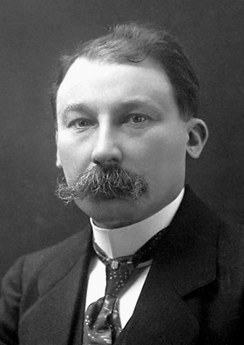
François Auguste Victor Grignard
French chemist and professor at the University of Nancy
Work on the development of phosgene and the detection of mustard gas
Nobel prize for the discovery of the Grignard reaction allowing the synthesis of large organic molecules

Slide 11
Gerhardt Schrader
German chemist who worked within the post First War chemical dye conglomerate, IG Farben
Work on pesticides in the 1930’s led to the chance discovery of a whole new class of toxic agents – the nerve agents
This opened up a completely new area of chemical warfare – the attack on the nervous system.

Slide 12
The beginnings of modern chemical warfare
1854 – the British chemist Lyon Playfair suggested the use of a shell containing cyanide to break the siege of Sevastopol
1862 – the US Civil War: the chemist John Doughty suggested the use of shells containing chlorine against an entrenched enemy
Both suggestions rejected by the military on moral grounds

Slide 13
Chemical agents: weapons of desperation
Both the previous examples demonstrate that chemical warfare was considered where there was a situation of military stalemate
Exactly the conditions of the trench war in 1915
1915 and other examples of the military use of chemical agents through the 20th century show that gas warfare is driven by conditions of stasis in battle
The use of chemical warfare agents against unprotected civilians different: weapons or terror.

Slide 14
The control of chemical warfare prior to the First World War
1675 – Strasbourg treaty following the use of incendiary devices by Bernhard von Galen, Bishop of Munster
1899 Hague Convention banned the use of chemical weapons but only if delivered by shell or other projectiles

Slide 15
Chemical weapons acting on the lungs and respiratory tract
Development by the Germans based upon strong industrial capacity
Earliest lung damaging agents were widely – used toxic industrial chemicals: chlorine and phosgene
Although April 1915 is usually regarded as the first use of a lung damaging agent there were earlier attacks

Slide 16
The first use of lung damaging agents
1914 – use of lachrymogens ( which are not classed as chemical warfare agents) by the French Army to harass the enemy
January 1915 – German use of T – shells ( containing the irritant xylyl bromide) against the Russians at the Battle of Bolimov
Attack failed since the cold conditions did not permit evaporation of the agent
The Russians did not think it worthwhile to report this attack to the Allies since the gas was of little effect

Slide 17
Ypres: April 22nd 1915: the first proper chemical warfare attack
German attack against Zouave and Canadian troops in the Ypres salient
168 tonnes of chlorine released by the Germans from 6000 prepositioned cylinders. Aerial intelligence warnings ignored
Mass casualties and fatalities from upper respiratory tract effects and toxic pulmonary oedema.
Accurate figures not know but estimated to be 5000 dead and 10000 wounded
Further chlorine attacks two days later, but the line was secured by the Allies
The Germans created a hole several km wide in the front but could not exploit the advantage due to non provision of reserves.

Slide 18
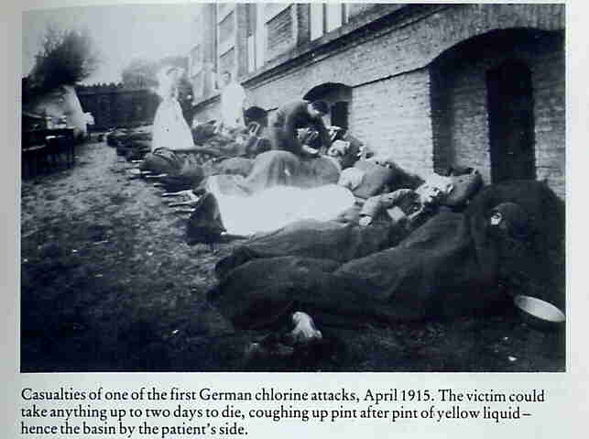

Slide 19
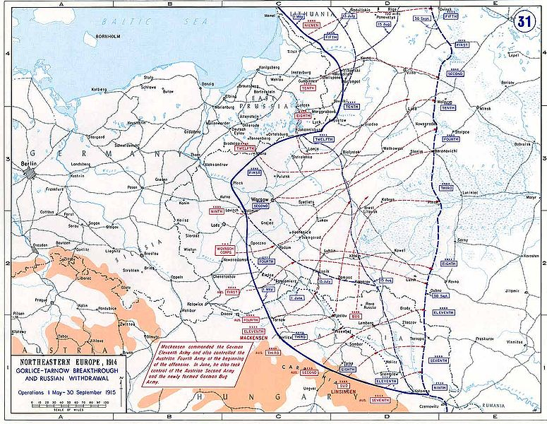
Further chlorine attack at Bolimov: May 1915
6000 dead and 20,000 wounded
First lesson of gas warfare for the Russians which dominated their military thinking for the next 100 years.

Slide 20
Key lessons from the first chemical attacks using lung damaging agents
Effectiveness of inhaled chemical agents against unprotected and untrained troops
The very high concentration of chlorine achieved at Ypres produced toxic pulmonary oedema quicker that 18 – 24 hours. An example of inconsistency of the Haber principle in some cases
Totally unprepared medical responses

Slide 21
1915 – 1918 the continuing use of inhaled agents
Development of phosgene and diphosgene which penetrated further into the lungs than chlorine and had a greater toxicity. Also these agents were heavier and more persistent
Dual latency
Initial choking sensation followed by an apparent rapid recovery following moderate exposure
Development of fulminating pulmonary oedema after 18 – 24 hours

Slide 22
Medical countermeasures against lung damaging agents
Little or none at the time although it was quickly realised that the first attack was with chlorine,
Limited availability of oxygen therapy
Importance of resting a patient who had been exposed to phosgene well understood - reduction of pulmonary artery pressure

Slide 23
Respiratory protection
Effectiveness of inhaled chemical agents gradually reduced by the development of filtration respirators
1915 Early devices – pads of cotton soaked in urine

Slide 24
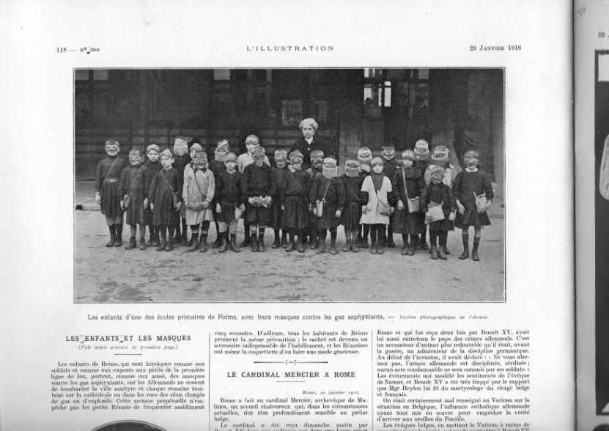
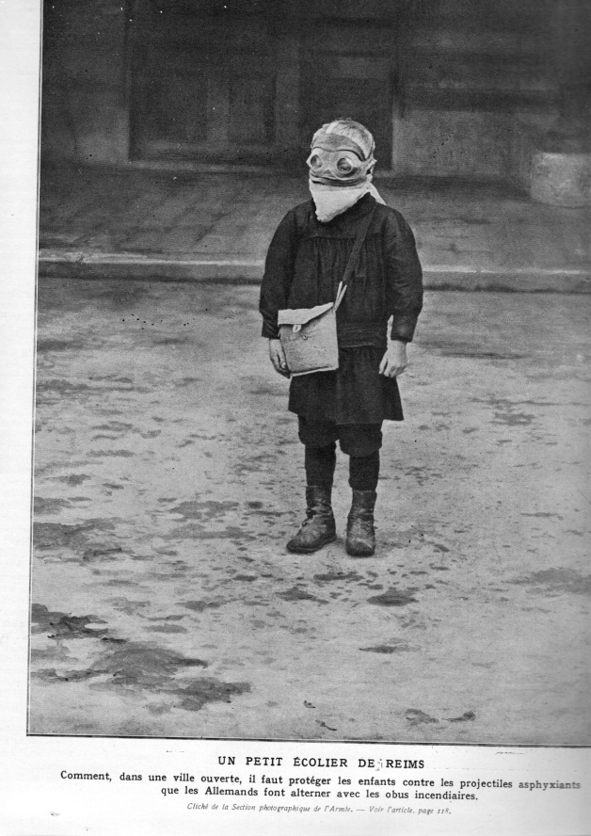
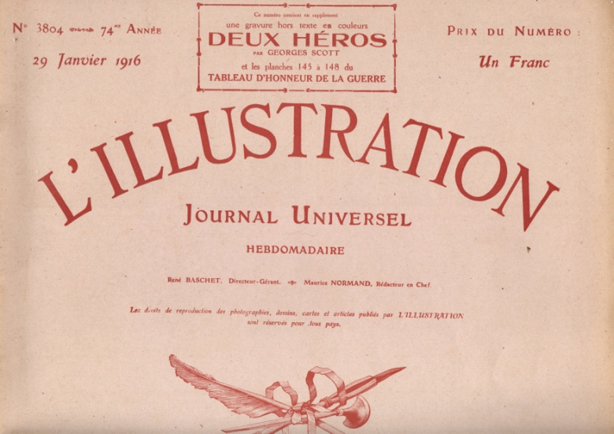
Early civilian respirators: Reims, 1915

Slide 25
Lung damaging agents post WW 1
Continued fear of aerial attack on civilians who were untrained and unprotected
Mass issue of respirators to civilians at the start of WW2
Better protection and training reduced the effectiveness of pulmonary oedemagens agains trained troops
But – the hazard from lung damaging agents remains to the present day
Chlorine and phosgene are widely – used industrial chemicals
2006 – Terrorist chlorine attack in Iraq
Medical countermeasures against pulmonary oedemagens now well – developed
Airway and ventilation management
Steroids
Protective ventilation strategies and the management of ARDS

Slide 26
Agents acting on the skin and epithelial membranes: vesicants

Slide 27
1917: the arrival of mustard gas
Sulphur mustard (bis – 2 chloro ethyl sulphide) known since 1860
Rejected by the British as a chemical warfare agent because of its long latency of action
Germans realised its potential as an agent designed to wound and demoralise
Active through both skin and the respiratory tract – the agent is a liquid.

Slide 28
First use of mustard gas
July– use against Canadians who had no protective suits
First large scale use against the British at Nieuport
14,000 casualties, 500 of whom died within 3 weeks
August – first use against the French 2nd Army
100,000 shells fired causing 14,000 casualties

Slide 29
The effects of mustard gas
No immediate effects other than a smell of garlic or mustard
Early symptoms – rhinorrhoea and sneezing
After 2 – 3 hours development of skin erythema, followed by painful blisters
Breakdown of blisters causing deep ulceration with a long healing process
Respiratory tract damage in high concentrations – more marked at high temperatures
Important effects on the eyes – blindness ( usually temporary)

Slide 30
Casualties from mustard gas
Add details

Slide 31
1917 – 1918 – continued use of Mustard Gas until the end of the war
Germans continued heavy use of mustard gas shells
Allies did not use the agent until Cambrai in November 1917 after capturing a large stock of German shells
British and French production not effective until 1918
1918 – the war became more mobile but use of the agent continued
October 1918 – the wounding of Corporal Schikelgruber

Slide 32
1917 – 2014 : a century of research into mustard gas
Now known that the agent forms sulphonium ions in the tissues which attacks the guanidine nitrogen in DNA leading to cell death and mutations
Of all the chemical agents used in WW 1 mustard gas still remains a major hazard today. Still no antidotes or specific therapy after nearly 80 years of research

Slide 33
1919 – 1945: use of mustard gas against civilians
Use of mustard against civilians in Iraq by the British in 1922 and on a large scale by the Italians in Abyssinia in 1936
1937 - Use by Japanese against the Chinese in Manchuria
Widespread fear that the agent would be used against civilians Europe
33 Large stocks of mustard held by both sides but chemical weapons not used since much of the war was very mobile
1940 – Churchill planned a massive use of mustard gas against a possible German invasion of Britain

Slide 34
1943 – the Bari harbour incident
Large scale Luftwaffe attack against Allied ships in Bari harbour
USS John Harvey bombed and released a large quantity of its cargo of mustard gas into the sea
Heavy naval and civilian casualties
Confirmed the view that chemical warfare agents were ‘weapons of mass destruction’

Slide 35
Mustard gas: 1945 – 2014
Mustard gas still regarded as a major hazard but its position during the Cold War eclipsed by the development of the nerve agents
Iran – Iraq War 1982 – 88
First major use of mustard gas in battle since WW1
Pronounced effects on the respiratory tract in high temperatures
Iranian casualties sent to hospitals in Western Europe – confirmed evidence of chemical bronchiolitis in addition to skin lesions

Slide 36
The hazard of mustard gas today
Military formations equipped with total personal protection
Mustard gas can be detected and monitored easily
Civilians still remain a major potential target – particularly from terrorists

Slide 37
Chemical asphyxiant gases
Hydrogen cyanide
Carbon monoxide
actively reduce the distribution of oxygen to the tissues and its use in the mitochondria

Slide 38
HCN – early studies and use in WW1
Early French studies on toxicity disputed by the British
Barcroft and his dog
an early demonstration of the importance of species when determining toxicity

Slide 39
Uses of HCN in chemical warfare
WW1 – not much used due to difficulty in obtaining sufficient concentrations
WW2 – Zyklon B used by the Nazis in their extermination camps. Carbon monoxide also used in early attempts
Afghanistan 1984 – possible use by Russians against Taliban in caves

Slide 40
The current status of HCN as a chemical weapon
Regarded as being a potential terrorist threat
Plans for a terrorist device using cyanide salts and nitric acid discovered

Slide 41
Chemical agents affecting the nervous system
Central and peripheral nervous systems as targets
Work did not begin in this area until the chance discovery of nerve agents in the late 1930s
Crucial role of the German chemical industry – IG Farben, a conglomerate of several companies dating from 1925.

Slide 42
Agents attacking the cholinergic nervous system – the nerve agents
Discovery of ACh by Otto Loewi in 1921
Central and peripheral actions of acetyl choline well – known to anaesthetists
Critical role of acetyl cholinesterase in the autonomic and voluntary nervous systems

Slide 43
Gerhardt Schrader and the discovery of nerve agents
1936 – Schrader working on organophosphate pesticide compounds for IG Farben. Discovery of parathion and bladan.
(OP known since the mid 19th century – first OP discovered by de Clermont in 1863)
1936 – discovery of TABUN followed by SARIN and SOMAN

Slide 44
WW2 – production and stockpiling of nerve agents
Research programme placed under conditions of the highest secrecy.
By 1945 several hundred tonnes of nerve agents had been produced
In a secret factory at Dyhernfurth
Nerve agents never used in WW2
fear of reprisals since the Germans thought that the Allies must have discovered nerve agents (absence of publications fuelled this suspicion)

Slide 45
The collapse of Nazi Germany and the dispersion of nerve agents
Dyhernfurth factory captured by the Russians and reconstructed in Volgograd.
Beginning of the Cold War chemical arms race
Intense Allied research following the discovery of the new chemical agents
Highly toxic through both the inhalational and cutaneous routes
Highly lethal within a short period without medical intervention

Slide 46
Problems in managing the effects of nerve agents in 1945
Antimuscarinic effects of atropine known – but no effect at the neuromuscular junction and other nicotinic receptors
Artificial ventilation, a key step in managing the cholinergic syndrome was understood by some workers (eg Dautrebande) but IPPV was barely used at that time

Slide 47
The Cold War chemical arms race
Detection, protection and treatment
The original nerve agents (with the exception of TABUN were relatively non – persistent
Development of new agents ( VX and R 55 ( the Soviet version) produced agents that combined high toxicity with battlefield contamination
Development of better personal protective suits and treatment strategies for nerve agent exposure reduced their effectiveness against trained troops
Oximes ( to regenerate AChE), atropine (anticholinergic) and diazepam anticonvulsant were the mainstay of pharmacological treatment
Development of field ventilators by the 1980s that could be used in a contaminated environment

Slide 48
The use of nerve agents against civilians
As with Mustard Gas following WW1 civilians were a very vulnerable target
Iran –Iraq War 1982 – 88
Hallabjah 1988 – attack against a Kurdish village
Cocktail of chemical agents used in bombing attacks, probably to confuse the detection and identification of the agents used
Mustard Gas
TABUN
SARIN
VX
Little or no medical support available – 5000 dead

Slide 49
Tokyo – 1995
First documented production and use of Sarin by terrorists
Attack in metro
Very low dead to wounded ratio (12 dead) due to positive effects of early life support
Many thousands were mildly affected, including medical personnel who could not continue their work due to effects on the eyes
Attack underlined the importance of airway and ventilatory support. Several badly affected cases survived after a period of ventilation in hospital

Slide 50
Damascus – 2013
Sarin used against civilians in a rocket attack
Casualty estimates vary between 300 and 1,300
No co- ordinated civilian medical response

Slide 51
Chemical agents acting on the central nervous system
Nerve agents – epileptiform convulsions
1960 – development of agents that alter perception, cognition and the will to fight
LSD, BZ, Agent 15

Slide 52
1970 - the search for a non – lethal ‘knockdown’ agent
Intensive Soviet research into centrally active pharmacological compounds
-short chain neuropeptides eg Delta Sleep Inducing Peptide
2002 – Moscow theatre siege
Russian special forces use of a ‘calmative ‘ gas to attempt to anaesthetise all in the theatre
168 persons died of acute respiratory failure. Later Russian explanation that a ‘fentanyl’ had been used
Incident highlights again the importance of early airway and respiratory support for chemical casualties

Slide 53
Toxins
Cold War research and development into neurotoxins and DNA toxins
Botulinun toxin – discovery that this was active by the inhalational route
Other neurotoxins included saxitoxin and bleu water algal toxins
1972 biological and chemical warfare treaty classed toxins as being biological agents despite their essential chemical nature.

Slide 54
Attempts at control of chemical weapons
1899 Hague conventional – broken completely by all sides in WW1`
1925 Geneva convention – banned the first use of chemical weapons but not production
1972 BCW Treaty leading to chemical disarmament by US and the start of a massive new Soviet secret research and development programme.
Defectors after the end of the Cold War revealed that new super powerful nerve agents had been developed (Novichoks)
1992 Chemical Weapons convention and the establishment of the Office of the Prevention of Chemical Warfare in the Hague. OPCW currently the lead agency in investigating and controlling chemical weapons

Slide 55
Following 100 years of chemical warfare where are we?
Much of chemical warfare has been controlled
But – use of chemical agents in three areas of conflict over the past 10 years (Iraq, Libya and Syria) shows that the threat still remains
Growing concern about terrorist use of chemical weapons against unprotected civilians
Medical treatment of toxic trauma has improved but the essential lessons of early life support in often chaotic circumstances have still to be learned
Many emergency medical services now have trained responders who can operate within contaminated zones and training is improving
Trauma from chemical warfare agents remains relatively rare but the many lessons of the past 100 years must not be forgotten
Civilians remain particularly vulnerable and the fear of chemical weapons remains
Important for the medical profession to convey the message that chemical agents are not inherently ‘weapons of mass destruction’ and that protection and treatment exists.

Slide 56
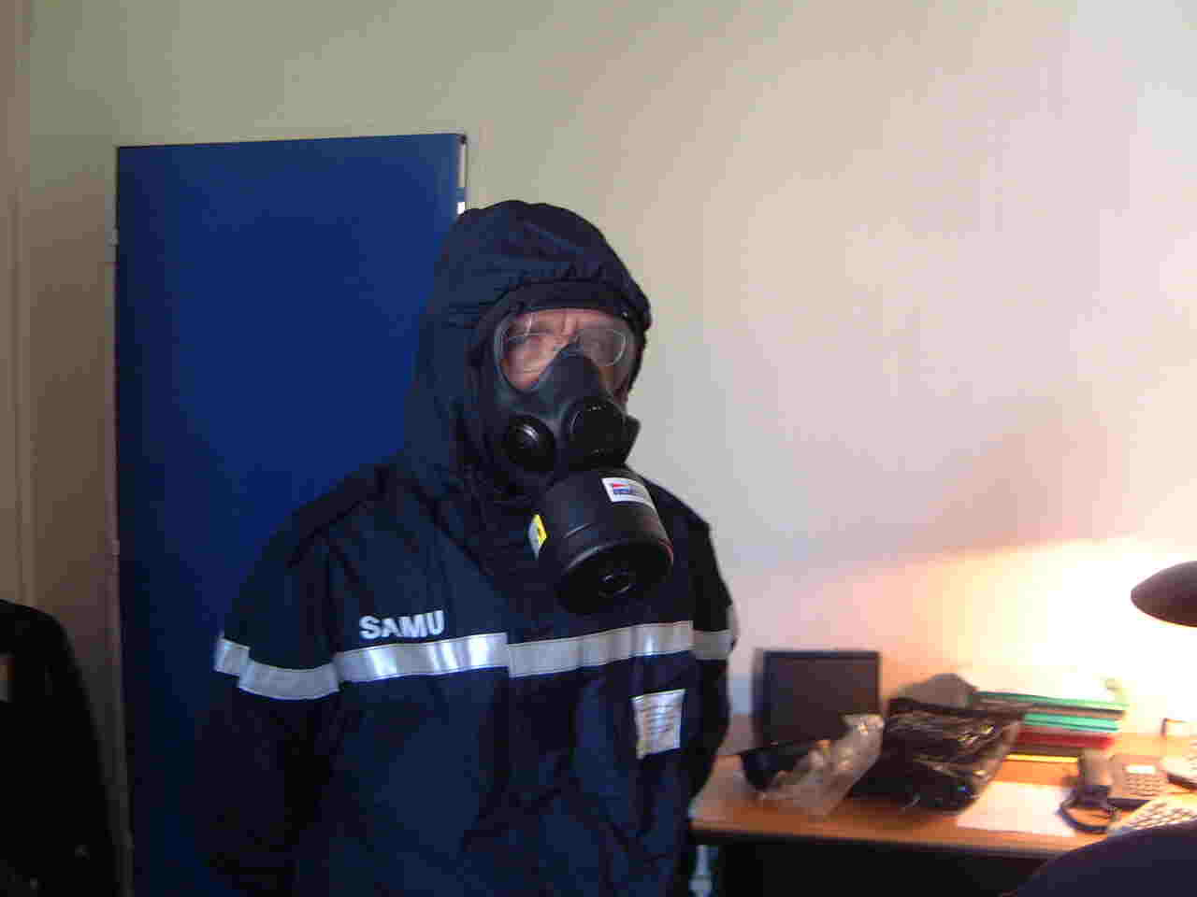
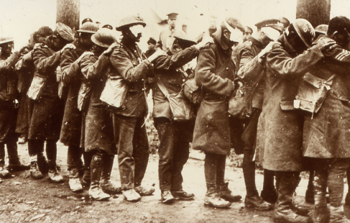
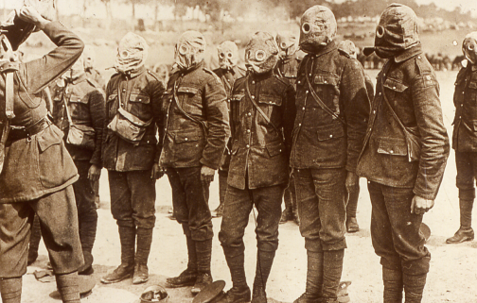
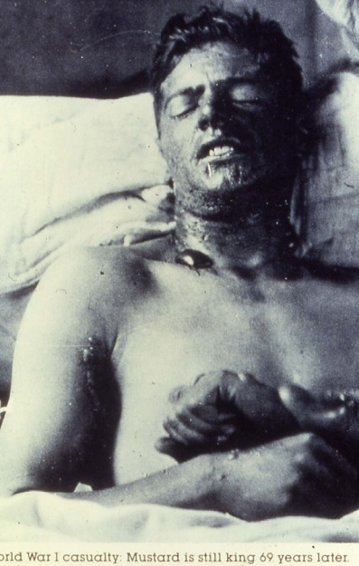
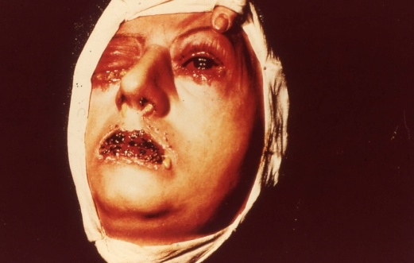
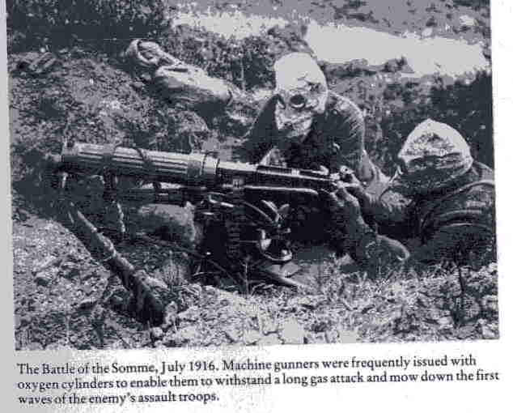
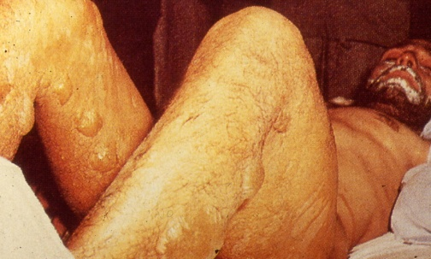
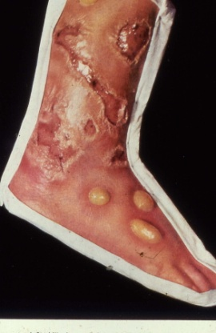
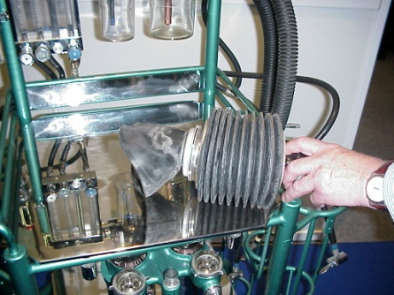
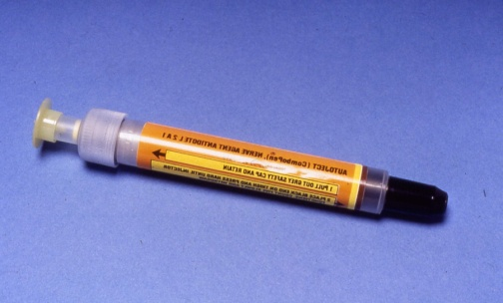

Slide 57
